Slide 1
How to Draw Entity Relationship Diagrams using MS PowerPoint

Slide 2
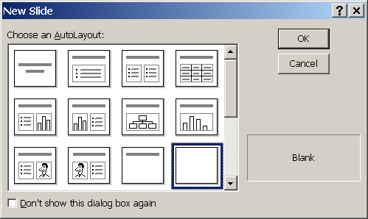
Create a blank presentation
Insert a new blank slide

Slide 3
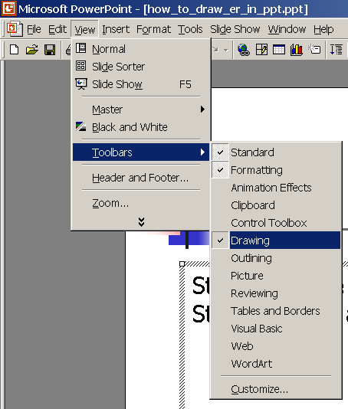
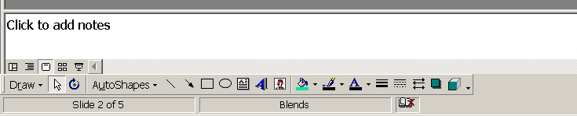
Drawing Tools in Powerpoint 2003
If you do not see the drawing tools on the tool bar, make certain they are displayed:
View -> Toolbars -> Drawing
This toolbar is usually at the
Bottom of the screen

Slide 4
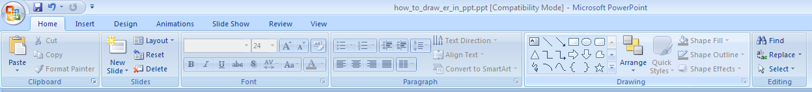
Drawing Tools in Powerpoint 2007
Look for the Drawing Tools located under the ‘Home’ tab

Slide 5
Model: Salon – Core Business
Creation Date/Time: August 30, 2002 8:01 PM
Modified Date/Time: September 9, 2002 3:45 PM
Last Modified by: R. Holowczak
12 pt. font
Gray background
To annotate your ER Diagram:
Create a legend on the diagram
Use the Text Box drawing tool
Include what the ER model represents, when it was created and last modified and who modified the diagram

Slide 6
Model: Salon – Core Business
Creation Date/Time: August 30, 2002 8:01 PM
Modified Date/Time: September 9, 2002 3:45 PM
Last Modified by: R. Holowczak
Creating an Entity
Use the textbox tool
Create 2 text boxes
  One for the entity name
    Enter Entity name in Bold
    Format the entity title box with No line
  Create another textbox for the entity attributes
    Format the entity box with a solid border
    Make dashes to indicate the attributes
    Put (id) next to the identifier(s)
    Drag line tool under identifier(s)
CUSTOMER
-CustomerID (id)
FirstName
LastName
CustPhone
Street
City
State
Zip
14 pt. font size and 2 pt. sized black border

Slide 7
Model: Salon – Core Business
Creation Date/Time: August 30, 2002 8:01 PM
Modified Date/Time: September 9, 2002 3:45 PM
Last Modified by: R. Holowczak
Once you have one nice entity, just copy and paste it to make more
EMPLOYEE
APPOINTMENT
SALONSERVICE
EmployeeID (id)
FirstName
LastName
PayRate
-AppointmentID (id)
AppointmentDate
AppointmentTime
ServiceID (id)
ServiceName
ServiceDuration
ServicePrice
CUSTOMER
-CustomerID (id)
FirstName
LastName
CustPhone
Street
City
State
Zip
PAYMENT
PaymentID (id)
PaymentDate
PaymentAmount
PaymentMethod
ReferenceNumber

Slide 8
Model: Salon – Core Business
Creation Date/Time: August 30, 2002 8:01 PM
Modified Date/Time: September 9, 2002 3:45 PM
Last Modified by: R. Holowczak
Weak Entities
For a Weak Entity, you will need to use 3 objects:
Create two text boxes
  one for the Entity title
  one for the Entity Attributes
Format both text boxes with No line
Encircle the Entity attributes with the rounded rectangle
SERVICERENDERED
LineItemNumber (id)
ServiceExtendedPrice
14 pt. font size and 2 pt. sized black border

Slide 9
Relationships
Mandatory – Optional
Mandatory 1
Optional 0
Mandatory 1 to many
Optional 0 to many
One-to-one
One-to-Many
Many-to-many
Examples:
One-to-many mandatory for both entities
One-to-many optional for entity A and mandatory for entity B
One-to-many optional for both entities

